Slide 1
Polyproteins an obstacle for virus genome annotation
Thomas Rattei, University of Vienna

Slide 3


Catalogs of protein families in viruses
Notes:
NCBI POG/pVOG
ViPR COG
eggNOG 4.5 viral NOG
VBRC VOCs

Slide 4

All-virus orthologous groups

Slide 7
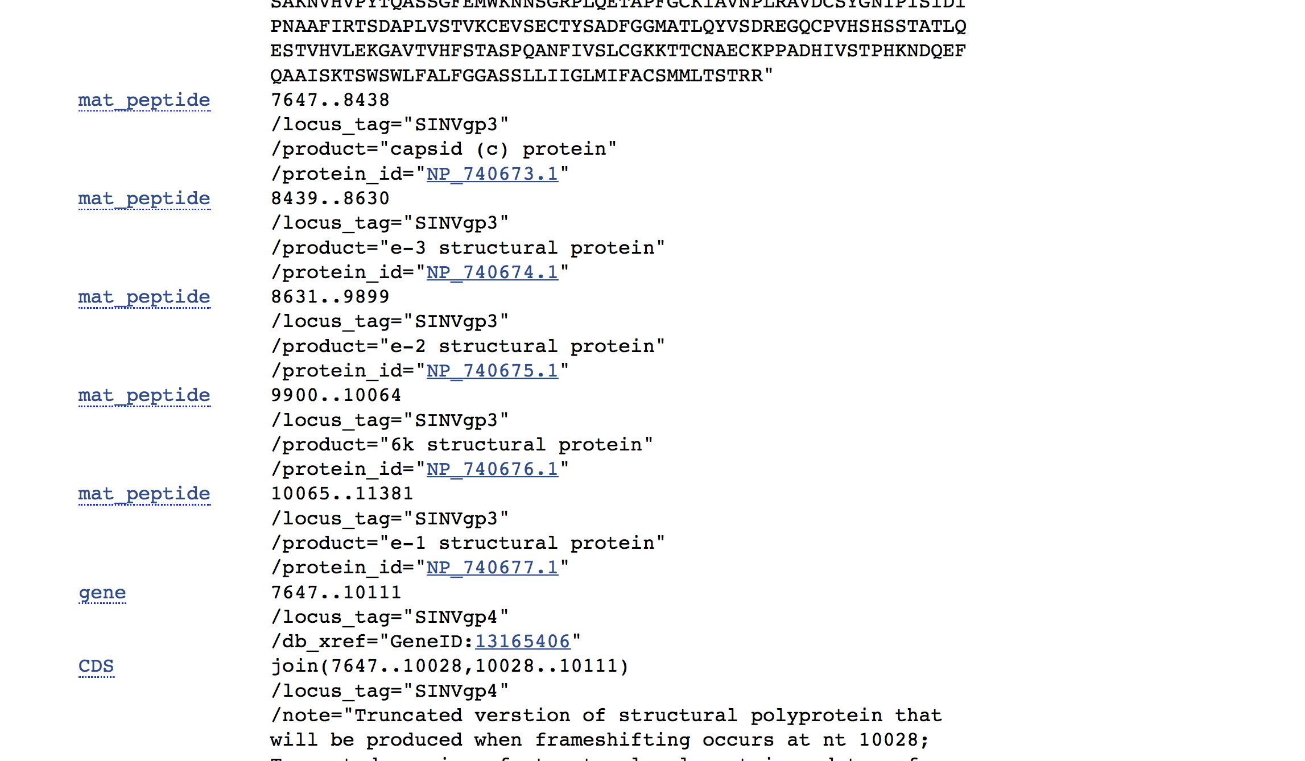
Polyproteins and their peptides

Slide 8
A typical flavivirus genome
© ViralZone

Slide 9
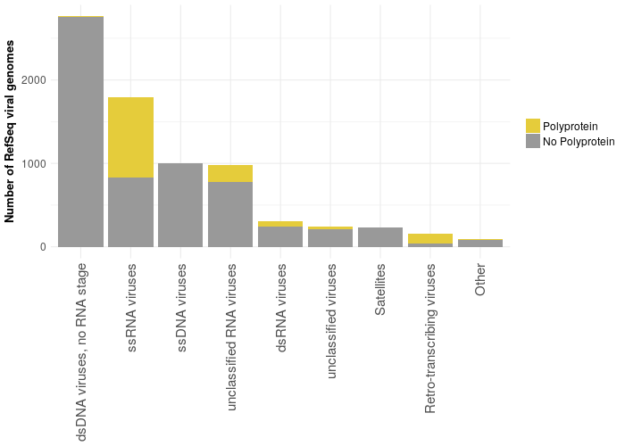

Slide 10
Alphavirus
Togaviridae
Togavirus
© ViralZone

Slide 11
VOGDB

Slide 12


Slide 13
Minimum number of annotated mature peptides
…
Comovirus | 8
Arteriviridae | 11
Alphavirus | 9
West Nile virus | 13
Waikavirus | 7
Marafivirus | 3
Sequivirus | 7
Picornaviridae | 11
Marnaviridae | 11
Togaviridae | 10
…

Slide 15
ssRNA viruses;ssRNA positive-strand viruses, no DNA stage;Picornavirales;Picornavirus;Aphthoviruses min=12 acc=3 rej=1
ssRNA viruses;ssRNA positive-strand viruses, no DNA stage;Closteroviridae min=2 acc=16 rej=24
Retroid viruses;Caulimoviridae;Petunia vein clearing-like viruses min=3 acc=0 rej=1
ssRNA viruses;ssRNA positive-strand viruses, no DNA stage;Picornavirales;Dicistroviridae min=4 acc=1 rej=24
ssRNA viruses;ssRNA positive-strand viruses, no DNA stage;Picornavirales;Iflaviridae;"Infectious flachery-like viruses" min=8 acc=0 rej=21
ssRNA viruses;ssRNA positive-strand viruses, no DNA stage;Tymovirales;Tymoviridae min=2 acc=3 rej=24
ssRNA viruses;ssRNA positive-strand viruses, no DNA stage;Nidovirales;Mesoniviridae min=9 acc=0 rej=6
ssRNA viruses;ssRNA negative-strand viruses;Bunyavirales;Nairoviridae;Nairoviruses min=5 acc=0 rej=10
ssRNA viruses;ssRNA negative-strand viruses;Bunyavirales;Hantaviridae;Hantaviurs min=2 acc=1 rej=23
ssRNA viruses;ssRNA positive-strand viruses, no DNA stage;Caliciviridae;Lagovirus min=8 acc=1 rej=2
Retroid viruses;Caulimoviridae;Cassava vein mosaic-like viruses min=2 acc=0 rej=2
ssRNA viruses;ssRNA positive-strand viruses, no DNA stage;Caliciviridae min=5 acc=2 rej=8
ssRNA viruses;ssRNA positive-strand viruses, no DNA stage;Caliciviridae;Sapporo-like viruses min=7 acc=0 rej=3
ssRNA viruses;ssRNA positive-strand viruses, no DNA stage;Nidovirales;Coronaviridae min=2 acc=0 rej=20
ssRNA viruses;ssRNA positive-strand viruses, no DNA stage;Tetraviridae;Omegatetravirus min=5 acc=0 rej=2
ssRNA viruses;ssRNA positive-strand viruses, no DNA stage;Caliciviridae;Vesivirus min=8 acc=3 rej=6
Retroid viruses;Retroviridae;Orthoretrovirinae;Deltaretrovirus;bovine leukemia virus, BLV min=6 acc=1 rej=0
ssRNA viruses;ssRNA positive-strand viruses, no DNA stage;Picornavirales;Sequiviridae min=5 acc=5 rej=2
ssRNA viruses;ssRNA positive-strand viruses, no DNA stage;Permutotetraviridae min=3 acc=1 rej=0
Retroid viruses;Caulimoviridae;Commelina yellow mottle virus group min=9 acc=0 rej=43
Retroid viruses;Retroviridae min=8 acc=4 rej=35
dsRNA nonenveloped viruses;Endornaviridae min=2 acc=0 rej=30
dsRNA nonenveloped viruses;Picobirnaviridae min=2 acc=0 rej=5
ssRNA viruses;ssRNA positive-strand viruses, no DNA stage;Togaviridae;Rubivirus min=5 acc=1 rej=0
ssRNA viruses;ssRNA positive-strand viruses, no DNA stage;Hepeviridae min=4 acc=1 rej=3
ssRNA viruses;ssRNA positive-strand viruses, no DNA stage;Nidovirales;Coronaviridae;Coronavirinae;Group 1 species min=13 acc=2 rej=18
ssRNA viruses;ssRNA positive-strand viruses, no DNA stage;Picornavirales;Sequiviridae;Comovirinae;Fabavirus min=8 acc=2 rej=2
ssRNA viruses;ssRNA positive-strand viruses, no DNA stage;Picornavirales;Sequiviridae;Comovirinae;Nepovirus min=8 acc=3 rej=15
dsRNA nonenveloped viruses;Birnaviridae min=5 acc=1 rej=7
ssRNA viruses;ssRNA positive-strand viruses, no DNA stage;Nidovirales;Coronaviridae;Coronavirinae;Group 2 species min=13 acc=4 rej=8
ssRNA viruses;ssRNA positive-strand viruses, no DNA stage;Nidovirales;Coronaviridae;Coronavirinae;Group 3 species min=13 acc=1 rej=1
ssRNA viruses;ssRNA positive-strand viruses, no DNA stage;Velvet tobacco mottle virus group min=5 acc=4 rej=14
ssRNA viruses;ssRNA positive-strand viruses, no DNA stage;Picornavirales;Iflaviridae min=2 acc=1 rej=12
ssRNA viruses;ssRNA positive-strand viruses, no DNA stage;Idaeovirus min=4 acc=0 rej=3
ssRNA viruses;ssRNA positive-strand viruses, no DNA stage;Nidovirales;Roniviridae min=2 acc=0 rej=1
ssRNA viruses;ssRNA positive-strand viruses, no DNA stage;Benyviridae min=2 acc=1 rej=2
ssRNA viruses;ssRNA positive-strand viruses, no DNA stage;Tymovirales min=0 acc=151 rej=0
ssDNA nonenveloped viruses;Parvoviridae min=0 acc=85 rej=0
ssRNA viruses;ssRNA negative-strand viruses;negative-sense genome single-stranded RNA viruses;Rhabdoviridae min=0 acc=149 rej=0
dsDNA viruses;Tailed phages min=0 acc=1954 rej=0
dsDNA viruses;Herpesvirales min=0 acc=83 rej=0

Slide 16
Automatic annotation of polyproteins?

Slide 17
Bell and Lever, Trends Microbiol 2013

Slide 18
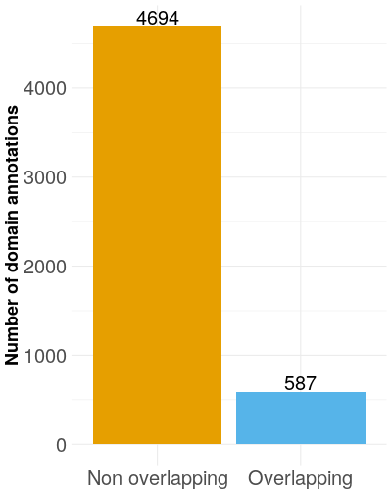
Do domain annotations agree with peptides?

Slide 19
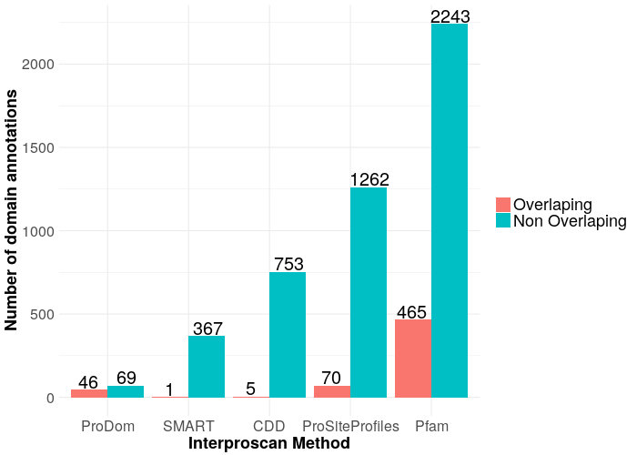

Slide 20
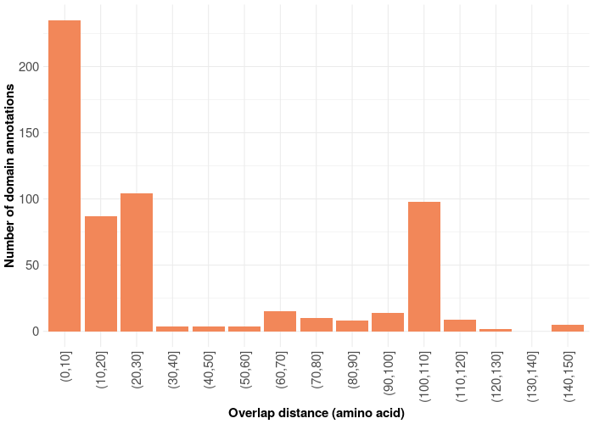

Slide 21
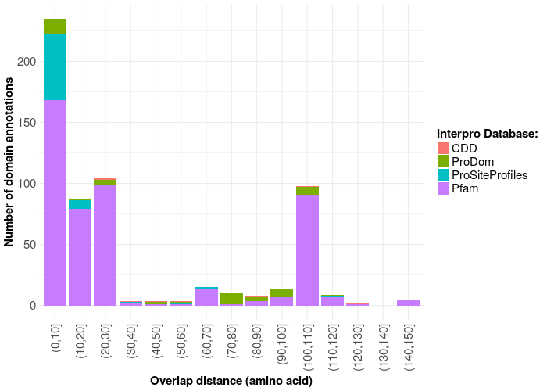

Slide 22
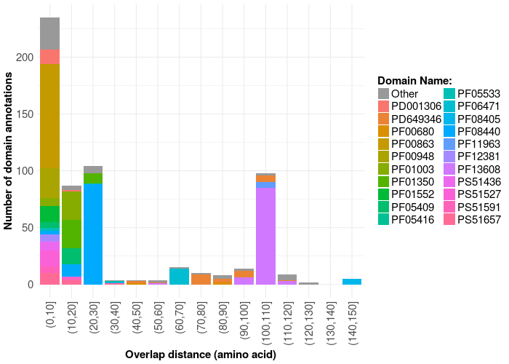

Slide 24
Togaviridae|Alphavirus
© ViralZone

Slide 25
Russo et al., J Mol Graph Model . 2010

Slide 26
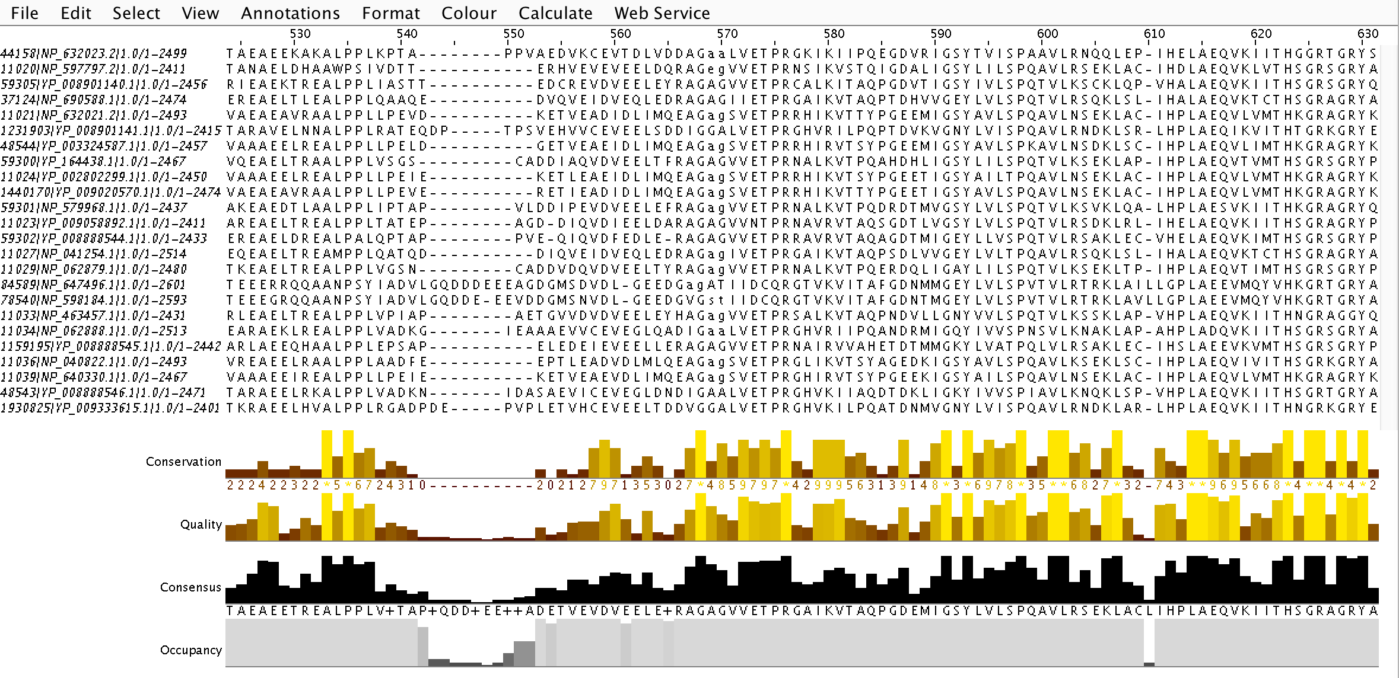

Slide 27
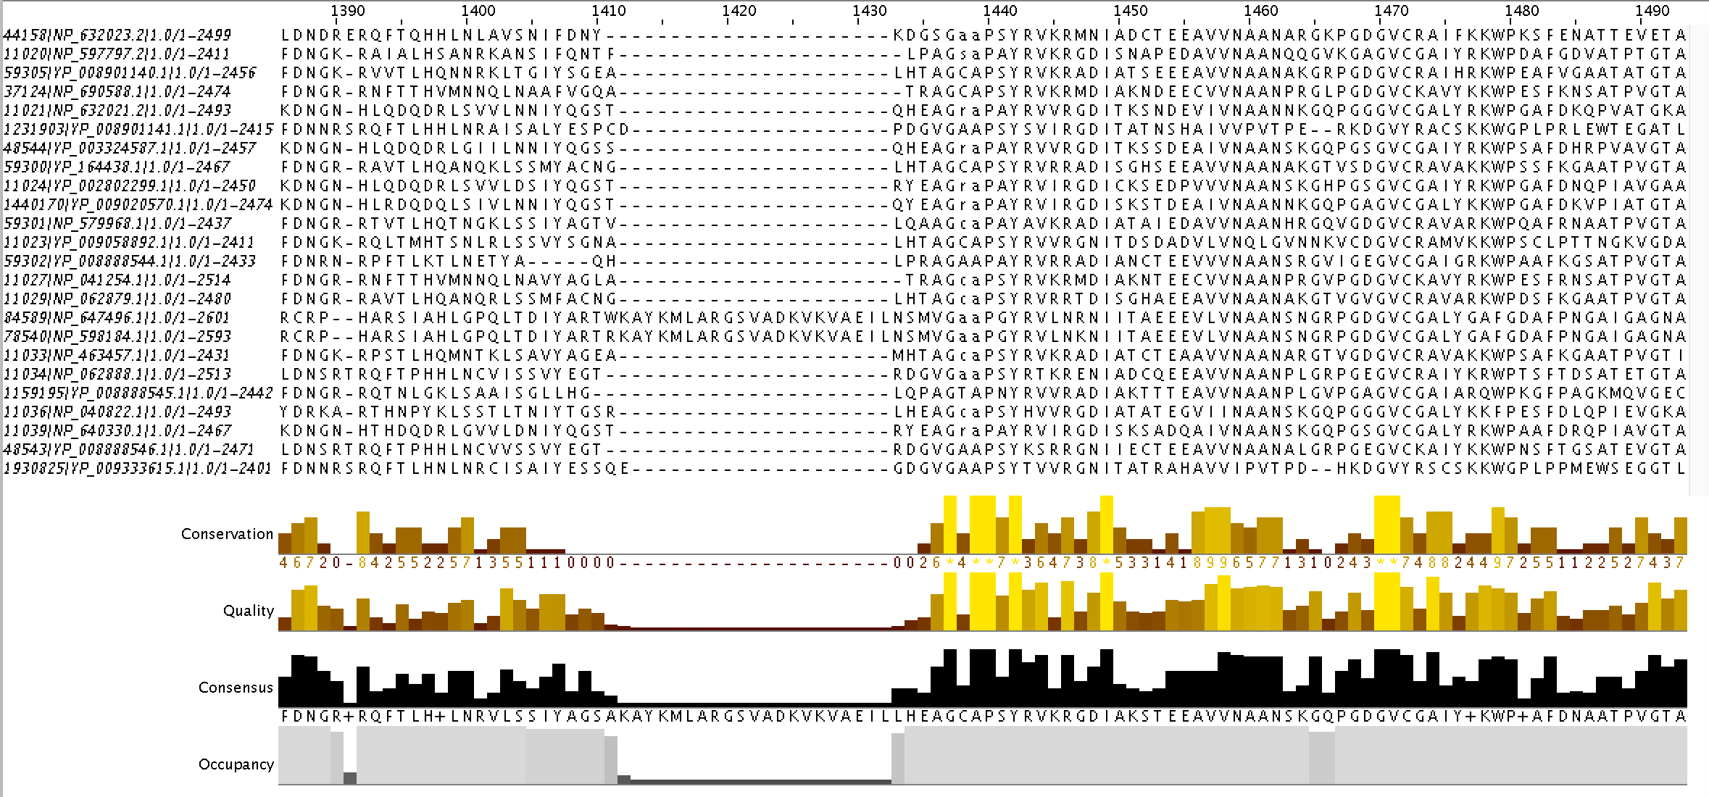

Slide 28
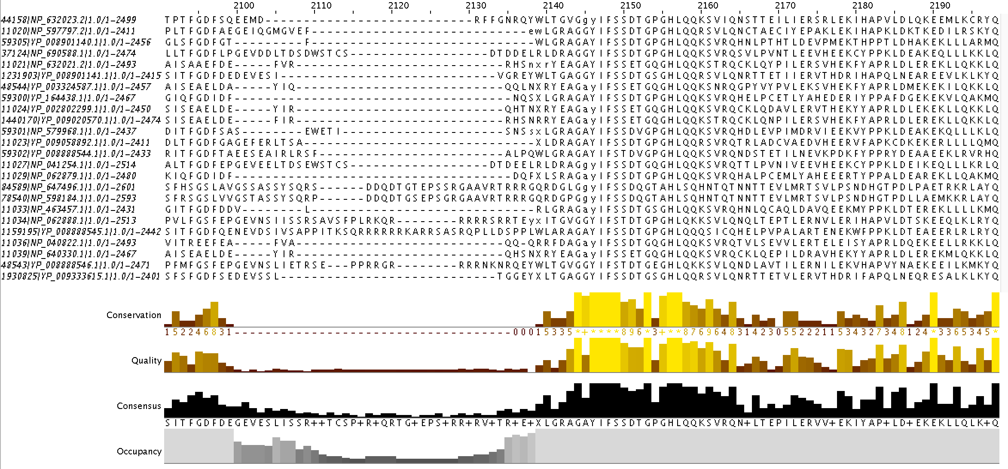

Slide 29
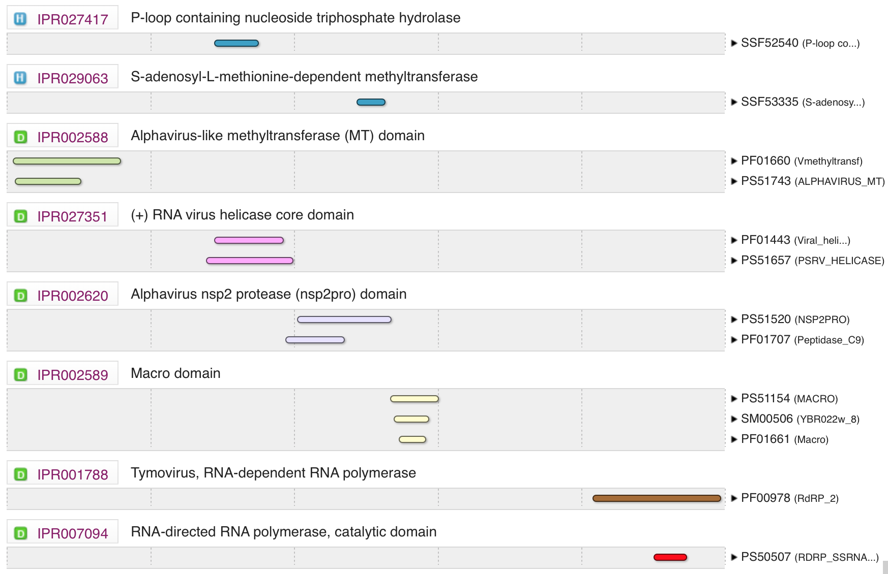

Slide 30
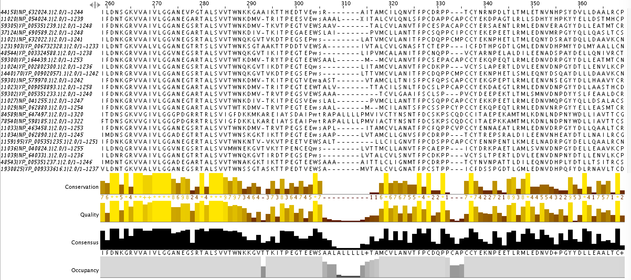

Slide 31
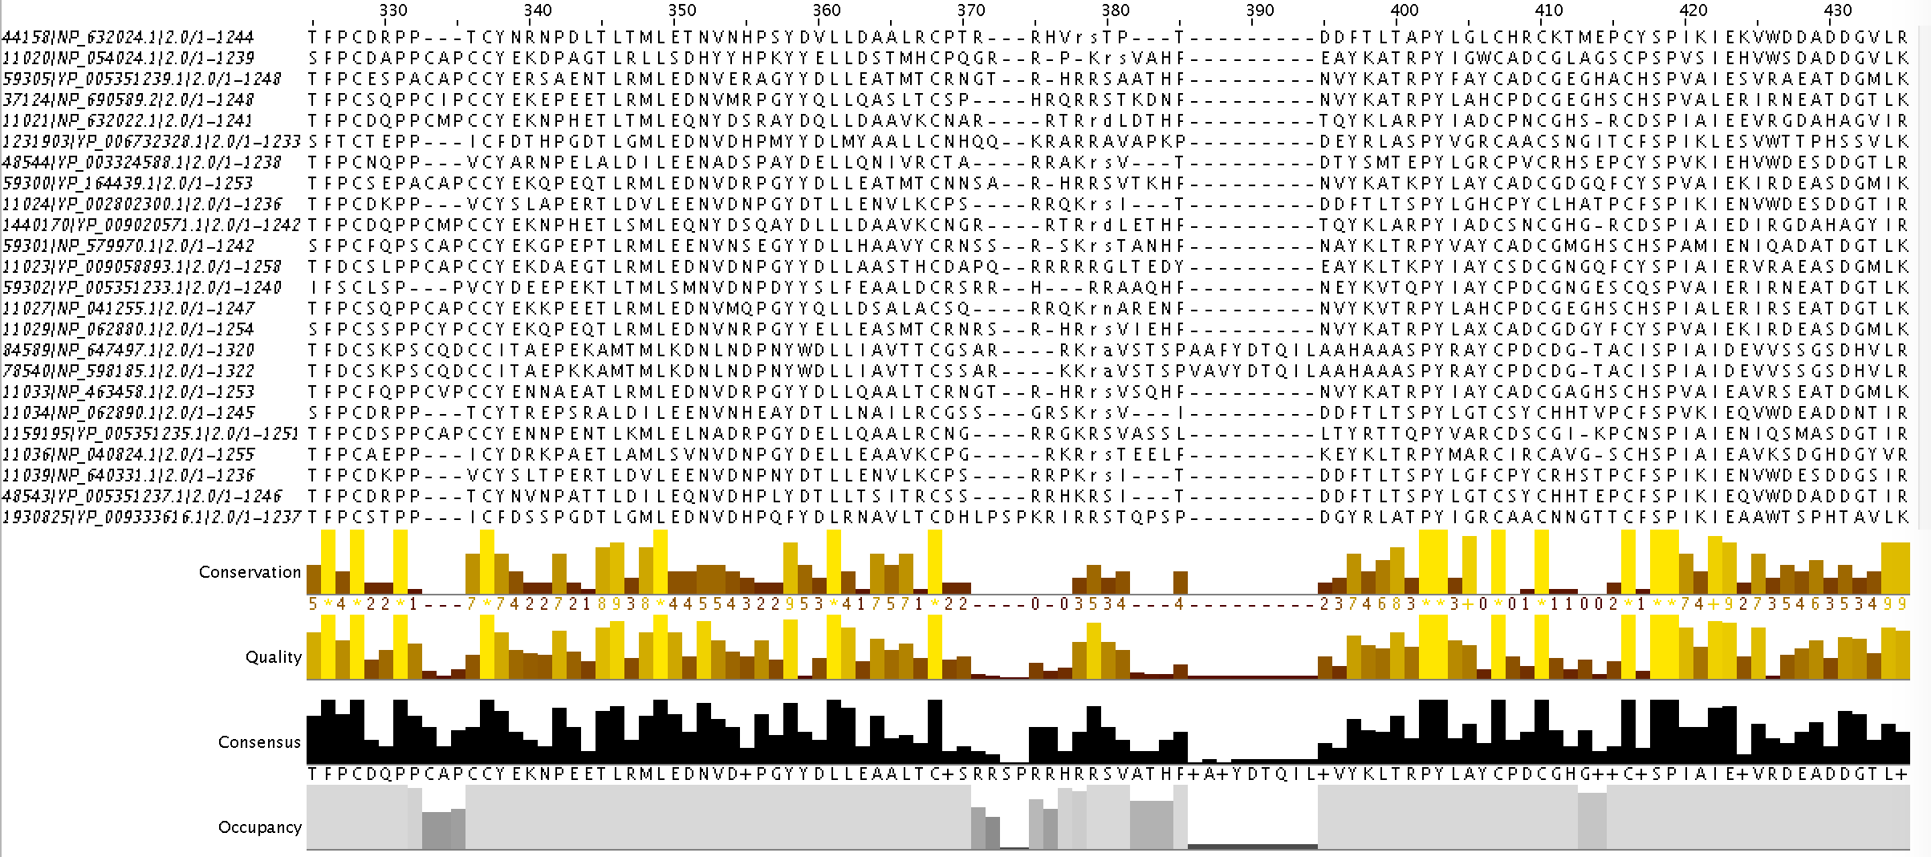

Slide 32
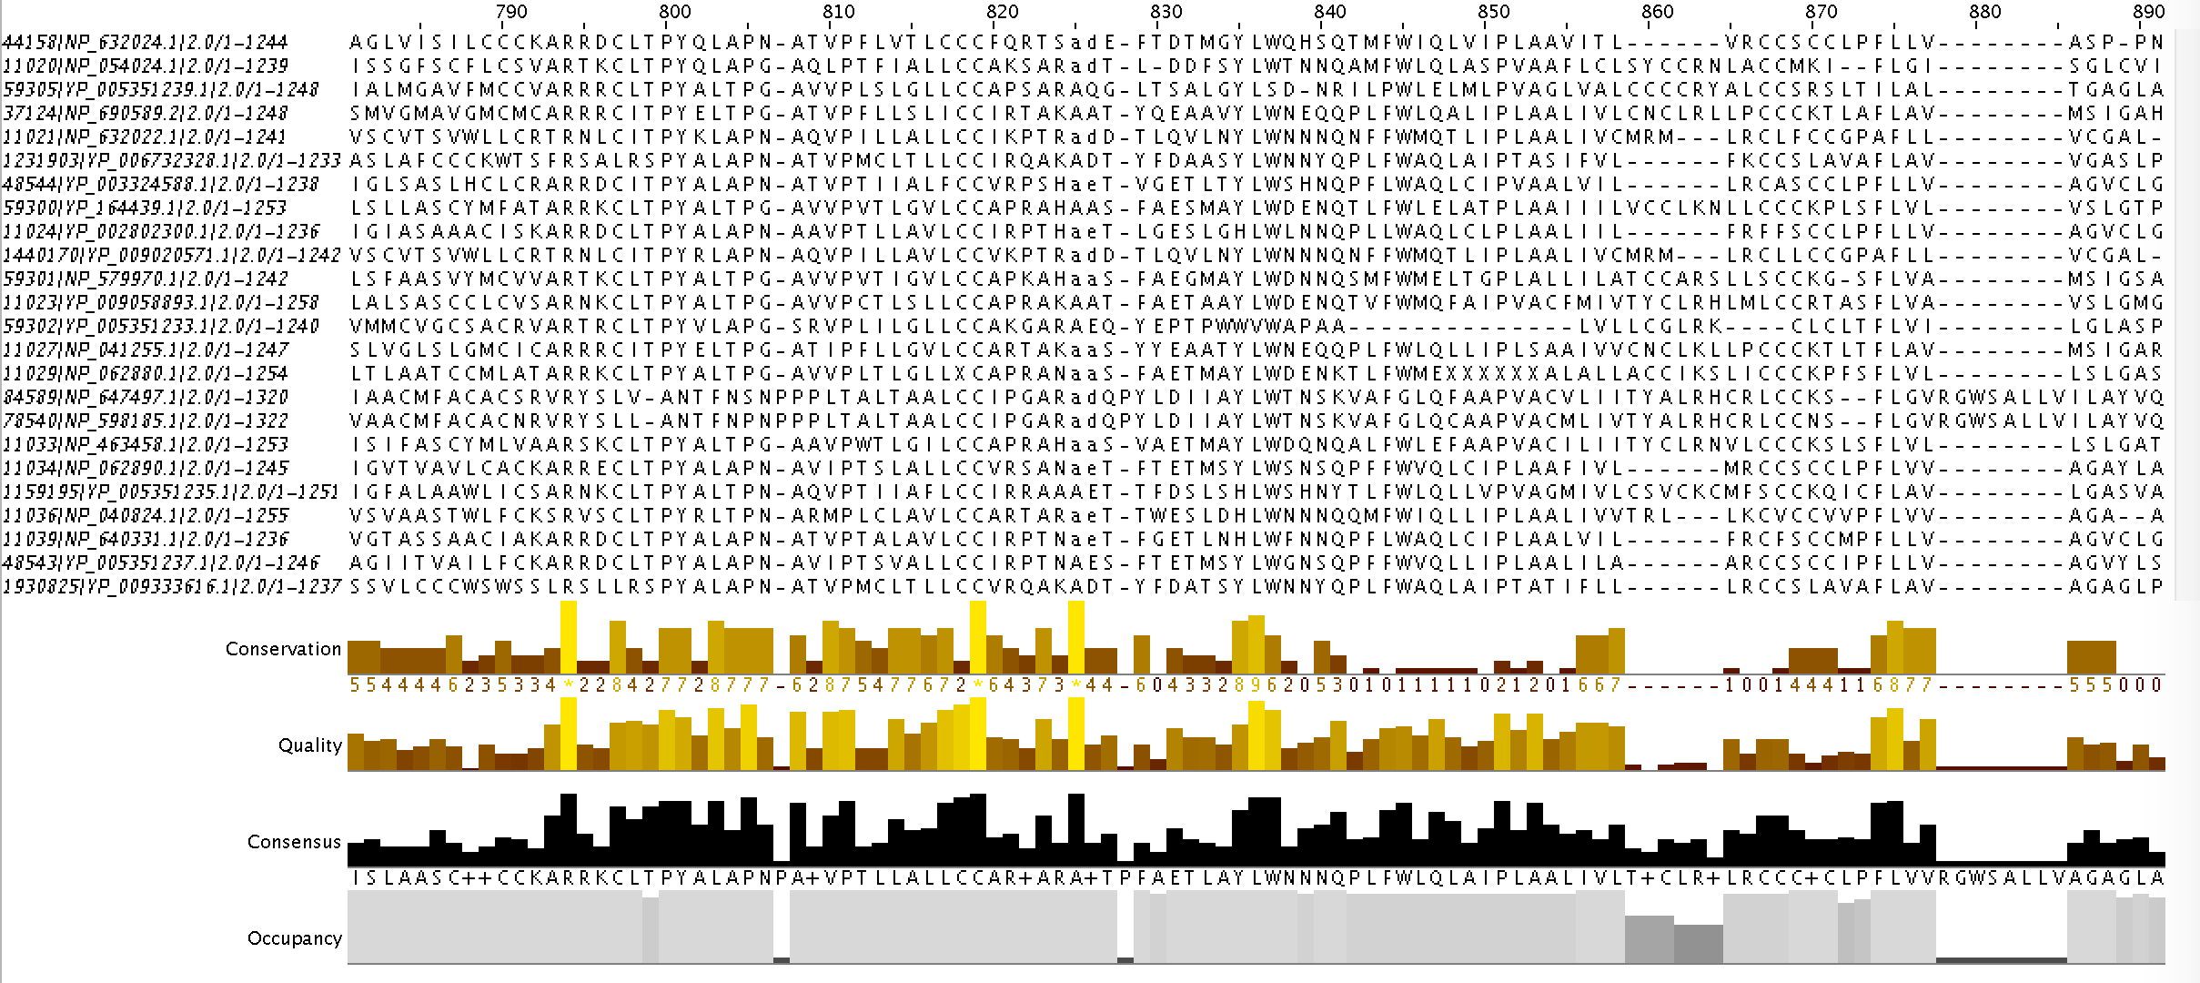

Slide 33
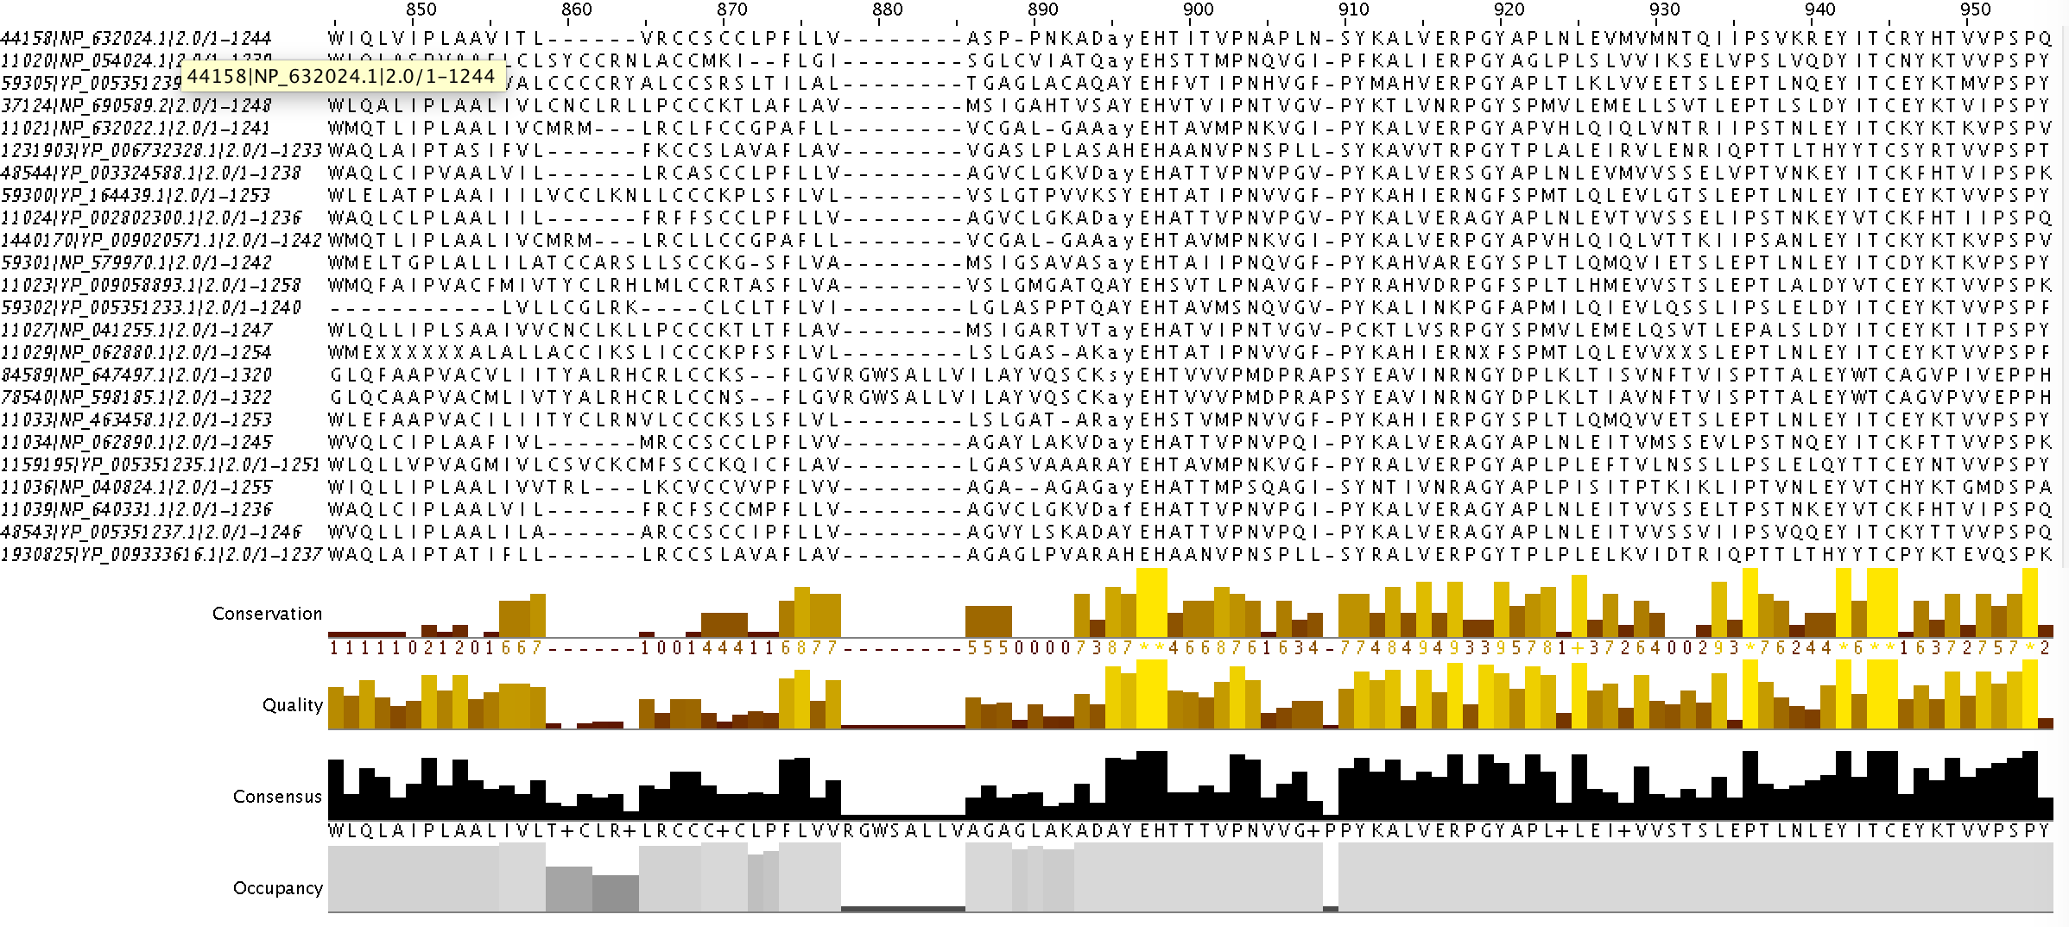

Slide 34
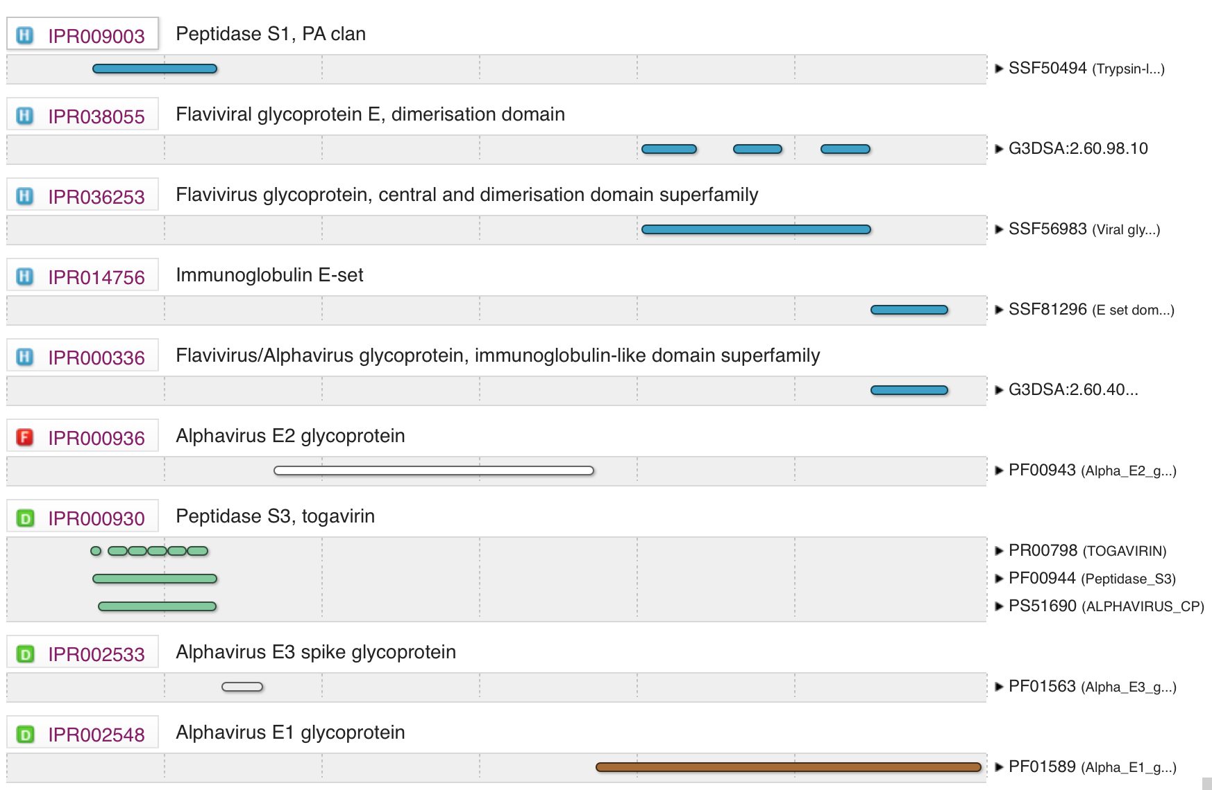

Slide 35
Automatic polyprotein annotation: concept
1. Extraction of homologous polyproteins from a genus or a homologous cluster

Slide 36
Automatic polyprotein annotation: concept
2. Validation of peptide annotation with domains

Slide 37
Automatic polyprotein annotation: concept
3. Multiple alignment, validation of conservation of sequence and cleavage sites

Slide 38
Automatic polyprotein annotation: concept
4. Propagation of cleavage sites to unannotated proteins

Slide 39
Release statistics of VOG86
http://vogdb.org
Release date | Mar 30, 2018
Source | NCBI Refseq release 86
Number of genomes | 6,460
Number of proteins | 252,517
Number of VOG | 22,318
Virus specific VOG | 16,965/18,511/19,214
Hellinger et al., in prep.

Slide 40
TODO list for next release(s)
Stable numbering of VOG
Refinement of clustering granularity by MSA/HMM verification
Improvement of VOG functional classifications
Include proviruses and environmental viruses?
Integration of pipeline into eggNOG
…?

Slide 41


Acknowledgements
Hans-Jörg Hellinger
Sabrina Jutz
Jean Mainguy
Nicole Webster
Patrick Laffy
Simon Roux

